Slide 1
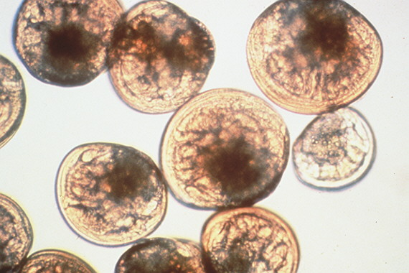
Effects of ocean acidification on Vibrio tubashii and Crassostrea gigas larvae
Elene Dorfmeier
University of Washington | S A F S

Slide 2
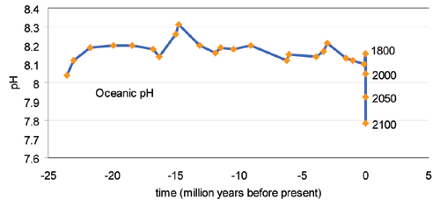
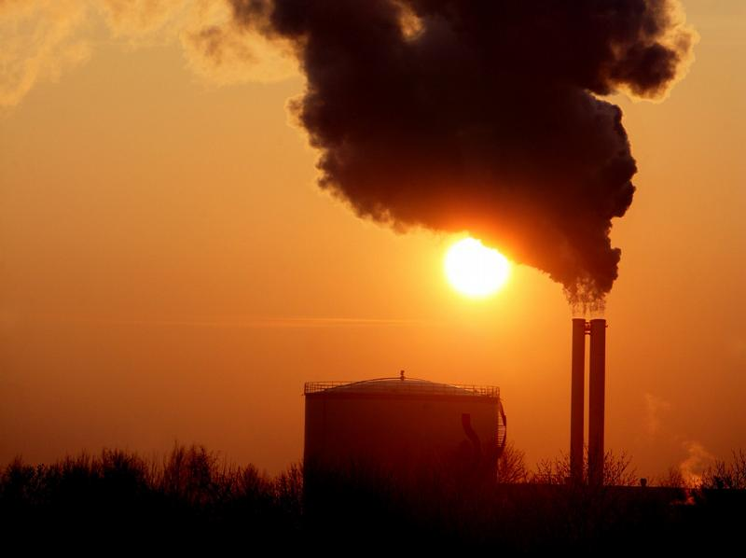
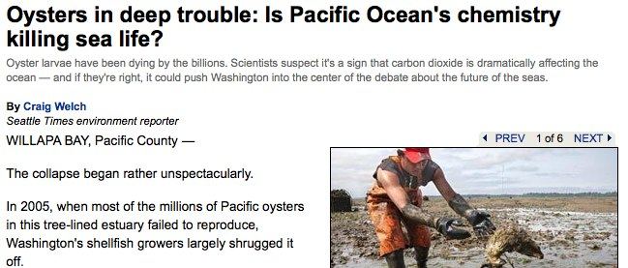
Problem: Ocean Acidification
Turley et al. 2006

Slide 3
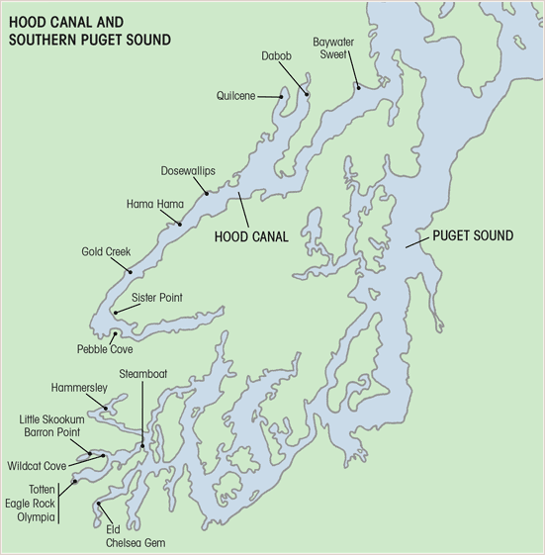
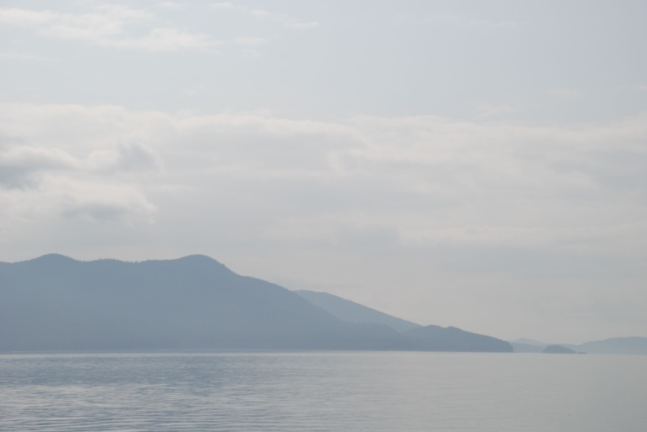
Local Problems for Bivalve Larvae
Low pH levels in the region
Reduced recruitment and survival
Bacterial disease

Slide 4
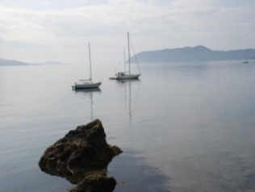
Impact of Acidification on the Oyster
Environment
Developing larvae are sensitive to the environment
Survival
Calcification
Metabolic processes
Metamorphosis
Recruitment
Disease susceptibility

Slide 5
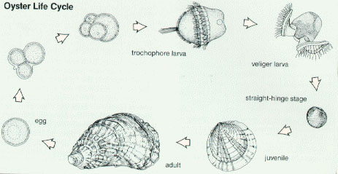
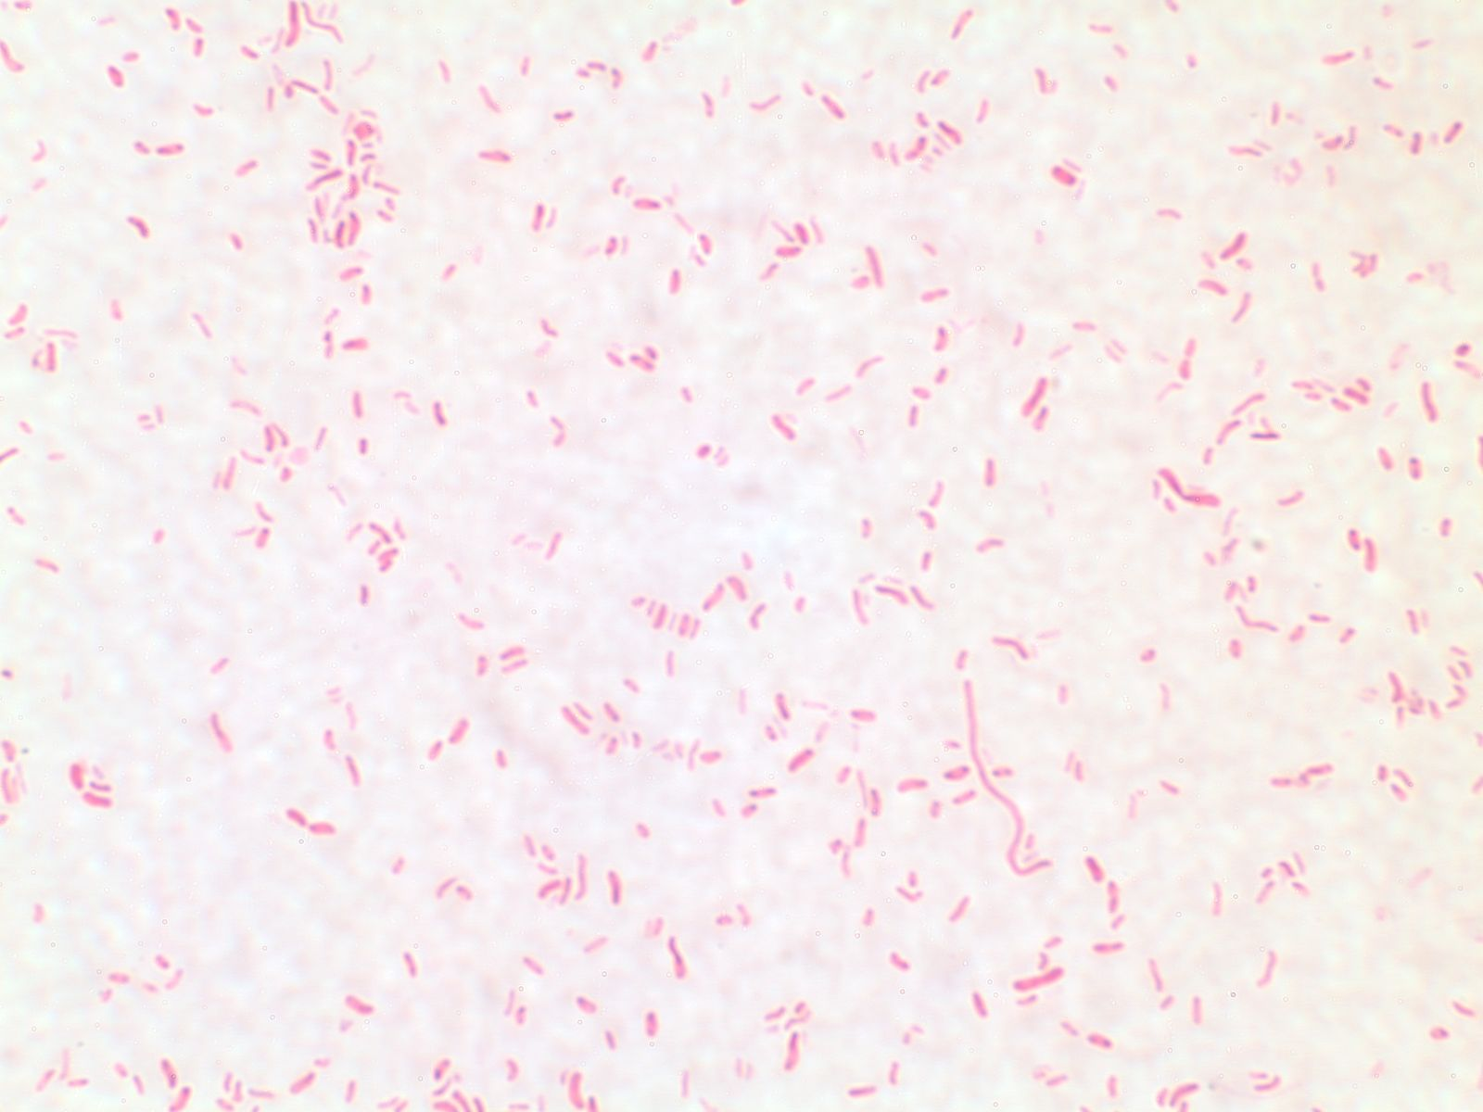
Scope of Study
Vibrio tubiashii
Pathogenesis

Slide 6
Collaborative Objectives:
Use controlled conditions to characterize and measure response of C. gigas and V. tubiashii
Fertilization, Growth, and Survival
Pathogen abundance
Differential gene expressions of pathogen and host
Identify hatchery conditions that are associated with poor larval survival
Water quality and bivalve recruitment analyses
Photo by Mackenzie Gavery
Notes:
The research presented here is part of a larger study that includes using molecular techniques to measure gene expression of the Pacific oyster in response to environmental cues and pathogen levels (including ostreid herpes virus). All environmental parameters described will all be examined individually and synergistically. (Experimentally: temp, salinity, pH, pathogen presence; Environ: DO, POM
Test the influence of different abiotic factors on normal oyster physiology using Differential Display PCR and qPCR to characterize gene expression.
Environmental sampling to access water quality and bivalve larval abundance in mulitple sites including Netarts Bay, Dabob Bay and Willapa Bay.
Pathogens will be monitored in these sites as well

Slide 7
How will ocean acidification affect Vibrio tubiashii growth and disease pathogenesis?

Slide 8
Use laboratory trials to examine the effects of pH, temperature and host presence on V. tubiashii
Goal:

Slide 9
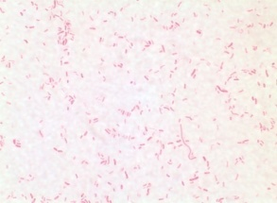
Vibrio tubiashii
Pathogen
Marine bacterium
Pathogenic to a variety of marine invertebrates
Recent epidemics of vibriosis have been correlated with significant mortality in bivalve larvae
Notes:
A period of rapidly falling temperature in 2006 coincided with a vibriosis outbreak at the Tillamook, Oregon hatchery.
In 1998 & 2007 when SST dropped along with production at the hatchery
Caused by intermittent upwelling and intrusion of warmer-than normal surface seawater

Slide 10
Vibriosis
Pathogen
Opportunistic bacterial infection
V. tubiashii appears to be highly pathogenic for C. gigas larvae (Estes et al. 2007; Elston et al. 2008)
Rapid onset of clinical signs can lead to larval mortality of close to 100% within 3-5 days of pathogen exposure
Photo by Robyn Strenge

Slide 11
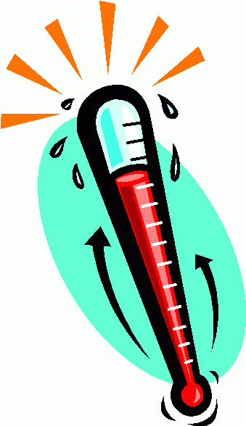
Factors Affecting V. tubiashii Proliferation:
Pathogen
Surface seawater temperature (Elston et al. 2008)
V. tubiashii blooms in 2006 and 2007
SST elevated in conjunction with oceanic upwelling
pH?
Temperature?

Slide 12
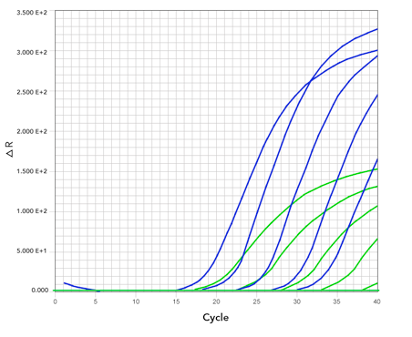
Measuring organism response to environmental change

Slide 13
Measuring Organism Response
Host
Pathogen
Environment
Pathogen abundance
Quantitative PCR (qPCR)
Gene expression
Reverse Transcription-qPCR

Slide 14
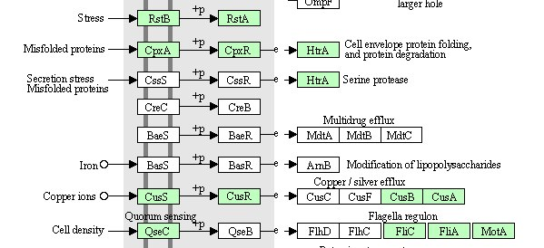
Pathogen
V. tubiashii Gene Discovery for RT-qPCR
Next Generation Sequencing
Comparative Genomics
Notes:
Approaches to gene discovery:
Proteomics: in general is the study of proteins – the main components of physiological metabolic pathways of cells.
NGS: Genomic DNA is fragmented into random pieces and cloned as a bacterial library. DNA from individual bacterial clones is sequenced and the sequence is assembled by using overlapping DNA regions

Slide 15
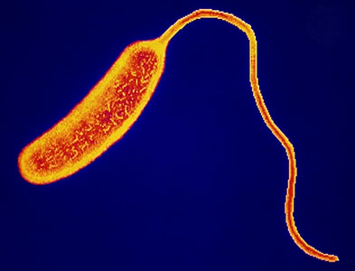
Pathogen
V. tubiashii Gene Discovery
Flaggelin
Metalloprotease
Sigma Factors
…?
http://www2.massgeneral.org/id/labs/larocque/images/image1.jpg
Notes:
Approaches to gene discovery:
Proteomics: in general is the study of proteins – the main components of physiological metabolic pathways of cells.
NGS: Genomic DNA is fragmented into random pieces and cloned as a bacterial library. DNA from individual bacterial clones is sequenced and the sequence is assembled by using overlapping DNA regions

Slide 16
Laboratory Trials
Environment
Host
Pathogen
pH
Temperature
Host presence

Slide 17
Laboratory Trials
Using controlled experiments to test environmental stressors on the survival, growth and physiology of pathogen and host
Parameters
pCO₂ levels: 380, 840 and ~2000 ppm
Temperatures: 14, 18, and 25º C
Notes:
To test the influence of various stressors on survival, growth and physiology of pathogen and/or host.
To test the impact of single and multiple biotic and abiotic stressors on C. gigas larvae we will set up 6 different experimental trials.

Slide 18
V. tubiashii Growth
Vt
V. tubiashii growth in response to changing environment
Measuring:
Growth, survival and gene expression
Parameters:
Full range of pCO₂ and temperature
Notes:
In media and in seawater

Slide 19
Host Presence and Pathogenesis:
C. gigas bacterial challenge
Measuring:
Gene expression
Pathogen abundance
Larval survival and morphology
Parameters:
pCO₂ levels: 380, 840, ~2000 ppm
Temperature: 18º and 25ºC
Cg
Vt

Slide 20
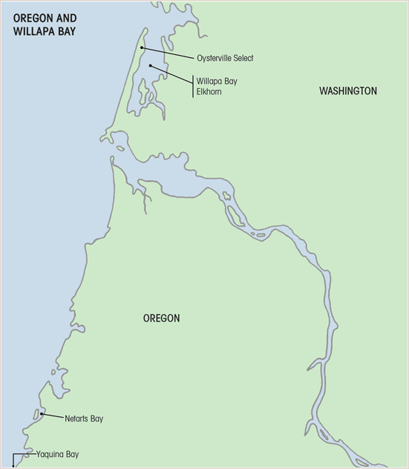
Taylor and Whiskey Creek Hatcheries
Bay Center Mariculture
Maps presented with permission from Rowen Jacobsen
Notes:
Two sites were selected for environmental sampling: areas surrounding Taylor and Whiskeycreek shellfish hatcheries.
We will enumerate Vibrio tubiashii associated with zooplankton, phytoplankton, and flocculent material and quantify pathogen levels in areas surrounding the hatcheries.
We will then sample larvae within the hatcheries and correlate conditions with wild sets.
Sampling will start in Mid-Winter (Feb) of this year and continue through summer.
Data analysis will start in the Fall of next year.

Slide 21
Future Impact
Better understanding of physical and biological tolerances of bivalve larvae and expression of V. tubiashii
Predict factors that contribute to larval mortality
Develop tools to be used as a measure for monitoring oyster and ecosystem health
Notes:
Investigate environmental stressors on C. gigas larvae and V. tubiashii

Slide 22
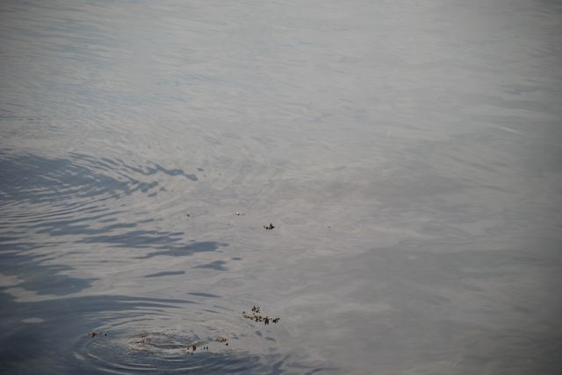
Acknowledgements
Saltonstall-Kennedy Program of NOAA
School of Aquatic and Fishery Sciences
UW Roberts Lab | UW Friedman Lab
NOAA - NWFSC
National Shellfisheries Association, Pacific Coast Section
Pacific Coast Shellfish Growers Association
Richard Wilson – Bay Center Mariculture
Russell Rogers - WDFW
Joth Davis - Taylor Resources, Inc.
Sue Cudd - Whiskey Creek Shellfish Hatchery, LLC

Slide 23
Questions?

